Slide 1

Welcome & Overview
Discovery and Learning with Big Data/Data Discovery

Slide 2

Outline
Instructor/TA
Course Description and Topics
Grading
Late Work Policy
Academic Integrity Policy
Python and Jupyter

Slide 3

Teaching Team
Instructor: Dr. Zeynep Orhan
Lecture Hours: See the syllabus and Canvas
Office Hours:
See the syllabus and Canvas
Email: Zeynep.Orhan@unt.edu
TA(s): See Canvas

Slide 4
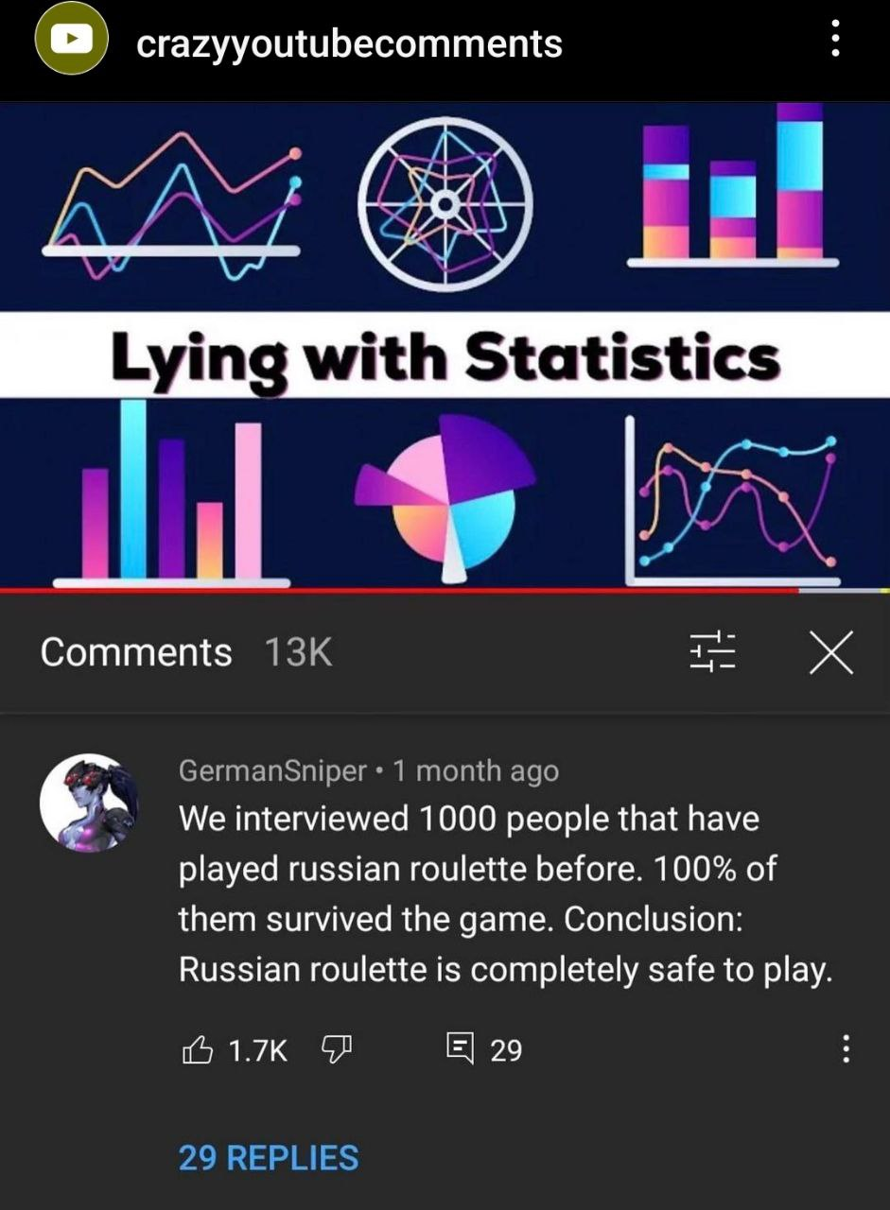
Course Description
This course introduces the fundamentals of data analytics and machine learning with big data.
The goal of this course is to provide students with both theoretical knowledge and practical experience, leading to mastery of big data analytics and machine learning, using both small and large datasets.
As these fundamentals are introduced, exemplary technologies will illustrate how machine learning can be applied to real-world solutions.
The problems are being considered in the context of big data analytics.
Exercises and examples will consider both simple and complex data structures, and data ranges from clean and structured to dirty and unstructured.

Slide 5
Course objectives
Develop an understanding of the fundamental concepts of big data and machine learning.
Apply Exploratory Data Analysis concepts leveraging the Python programming language and the Jupyter Integrated Development Environment (IDE).
Develop and articulate results from Supervised and Unsupervised Python Machine Learning models, including correctly identifying algorithms appropriate for the assigned data set.
Apply skills and knowledge learned in class to real-world case study problems and develop Machine Learning models to solve problems.

Slide 6

Topics
Python Basics
Data analytics life cycle
Data preprocessing
Exploratory Data Analysis (EDA)
Big data analytics and machine learning: Overview
Big data analytics and machine learning: Supervised Linear Algorithms.
Big data analytics and machine learning: Unsupervised Algorithms
Big data analytics and machine learning: Evaluating Algorithms
Big data analytics and machine learning with NumPy, Pandas, Scikit-Learn in Python

Slide 7

Textbook
Zybook: ADTA 5340: Discovery and Learning with Big Data
Sign in or create an account at learn.zybooks.com
See the syllabus and Canvas for instructions

Slide 8

Grading
See the syllabus and Canvas

Slide 9
Grading
Course Score (%) | Letter Grade
90+ | A
80-89.9 | B
70-79.9 | C
60-79.9 | D
Below 60 | F

Slide 10

Do your job!

Slide 11

Weekly Schedule
See the syllabus for details

Slide 12
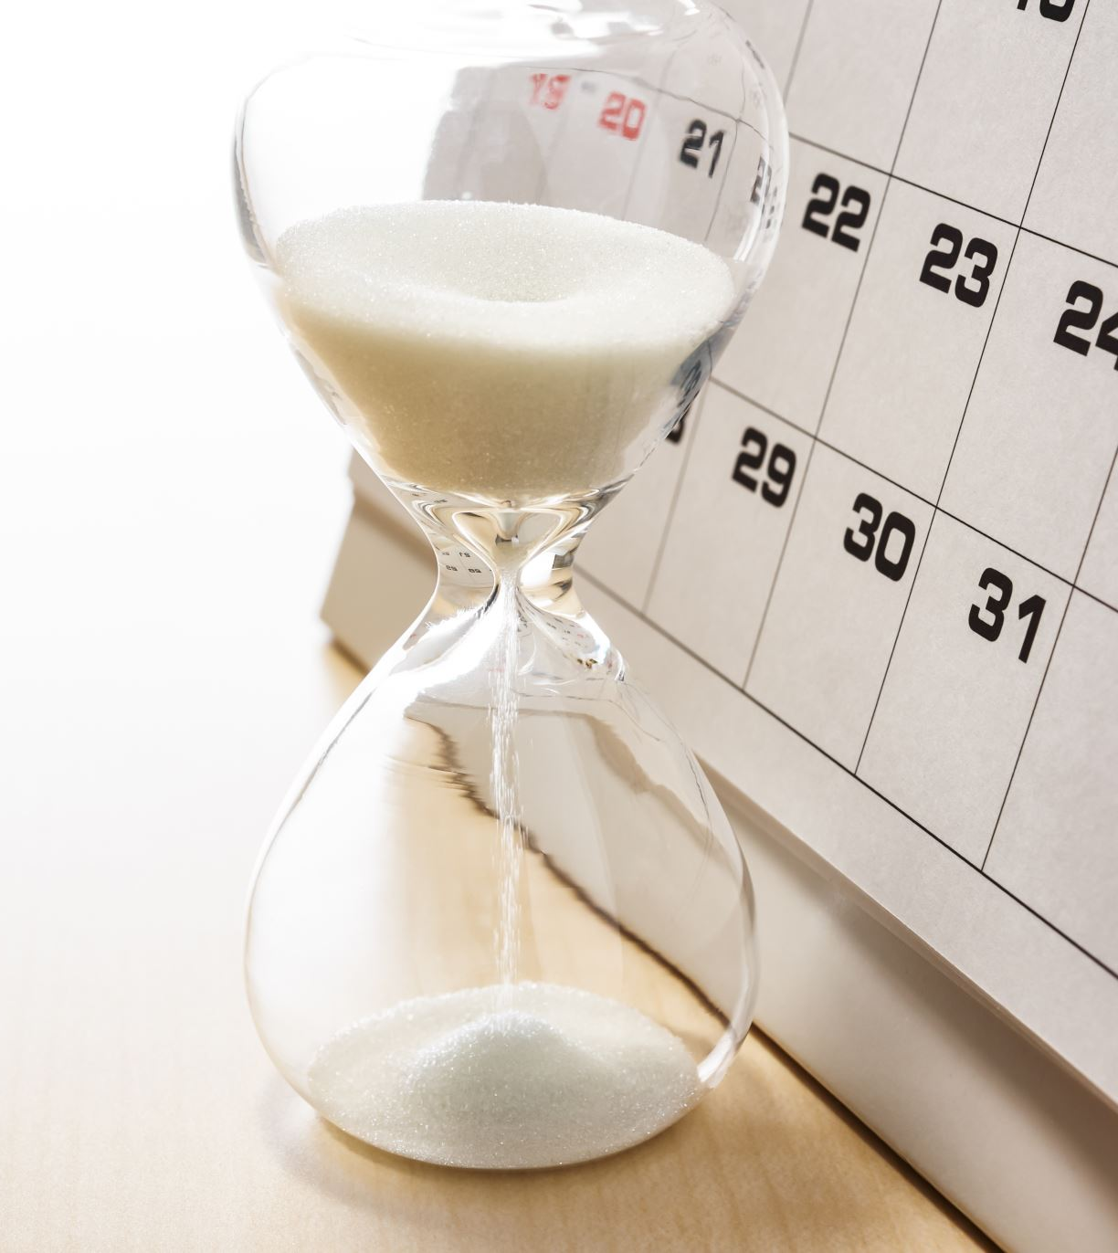
Course Policies
Late Work Policy
Assignment due dates are posted in the syllabus and on Canvas. Any changes to due dates will be updated on Canvas and communicated in an announcement. All work for this course is due no later than 11:59 pm (Central Time) on the designated date.
NO late submission of assignments, midterm, or project deliverables.
Late work will be assigned ZERO unless previously approved by the instructor. NO EXCEPTIONS!

Slide 13

Course Policies
Make-Up Policy
No make-up assignment or exams will be offered except for being approved in advance.
Students will be required to provide the necessary documentation.

Slide 14

Course Policies
Grade Disputes
You are required to wait 24 hours before contacting me or the TA to dispute a grade.
Within that time, I expect that you will review the assignment details and reflect on the quality of the work you turned in.
If you would still like to meet, email TA first to set up a meeting briefly describing the issue.
You should come to the scheduled meeting with specific examples that demonstrate that you earned a higher grade than you received.
If you may not solve the issue with TA, you can request to meet with me.
If you miss your scheduled meeting, you forfeit your right to a grade dispute.
If you do not contact me to schedule a meeting within seven days of receiving your grade, you also forfeit your right to a grade dispute.

Slide 15

Course Policies
Academic Integrity Policy
According to UNT Policy 06.003, Student Academic Integrity, academic dishonesty occurs when students engage in behaviors including, but not limited to
Cheating
fabrication
facilitating academic dishonesty
forgery
Plagiarism
sabotage
A finding of academic dishonesty may result in a range of academic penalties or sanctions ranging from admonition to expulsion from the University. Receiving a zero or even failing from the course are possibilities in case of academic integrity violation.
All works submitted for credit must be original works created by the scholar uniquely for the course.

Slide 16
Course Policies
Turnitin Notice
Turnitin is used as a tool to assist students in their scholarly writing to address plagiarism and usage of AI tools issues.

Slide 17
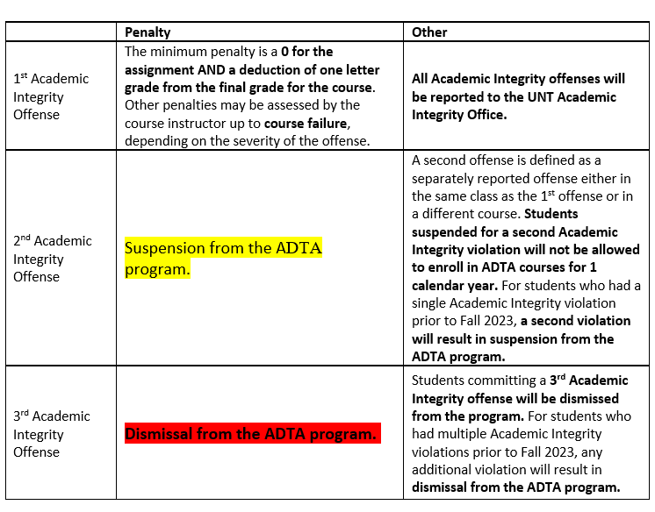
Course Policies
Advanced Data Analytics Integrity Policy

Slide 18
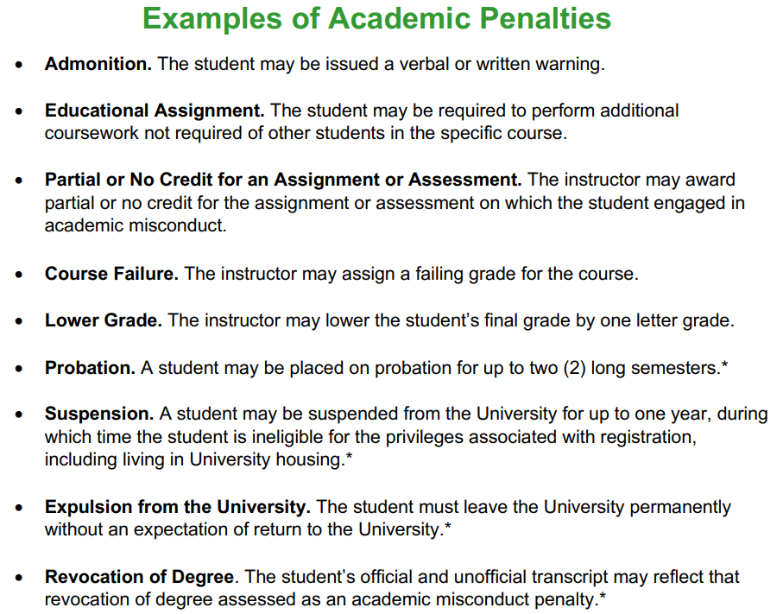

Slide 19

Topics

Slide 20
Characteristics of Big Data
“Big data is high-volume, high-velocity and high-variety information assets that demand cost-effective, innovative forms of information processing for enhanced insight and decision making.” (Gartner IT Glossary, n.d.)
“Big Data is a huge volume of data that forms from systems and is difficult to store, manage and analyze via standard methods” (Ridgeway, 2016).
“Big data is a term that describes large volumes of high velocity, complex and variable data that require advanced techniques and technologies to enable the capture, storage, distribution, management, and analysis of the information.” (TechAmerica Foundation’s Federal Big Data Commission, 2012)

Slide 21
Big Data
Volume –sizes and magnitudes of data are reported in tera/peta bytes. Data volumes are defined by time and data type.
Variety–different data types such structured, semi-structured, or unstructured.
Velocity–Information generation speed for its analysis.
Veracity–deals with data quality, uncertainty and reliability.
Value–How much information extraction adds value.
Variability–Number of dynamic data changes, different data sources, inconsistencies reported.
Valence–Interconnections and Interrelations.
9Vs: Veracity, Variety, Velocity, Volume, Validity, Variability, Volatility, Visualization and Value

Slide 22
Types of Data
• Structured, Semi-structured, and Unstructured
• Numerical, Text, Image files, Video files, audio files, etc.
• Interval (Quantitative or Numerical)
Real numbers such as heights, weights, incomes, and distances
• Nominal (Categorical or Qualitative)
Categories such as marital status, major, and ethnicity
• Ordinal
Values are in order
Example: Ratings 1=Poor, 2 = Fair, 3 = Good, 4 = Very Good, 5 = Excellent

Slide 23
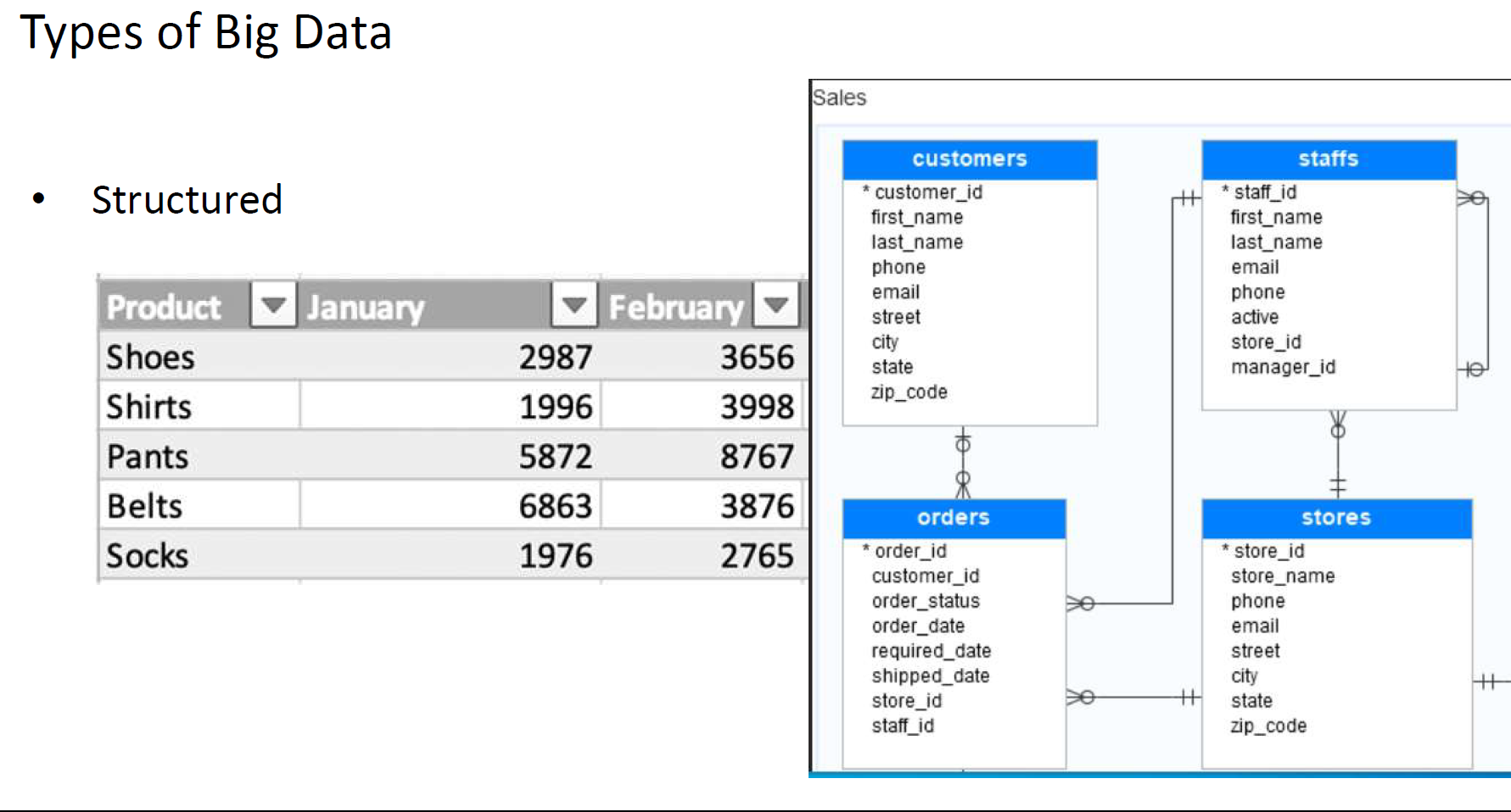

Slide 24
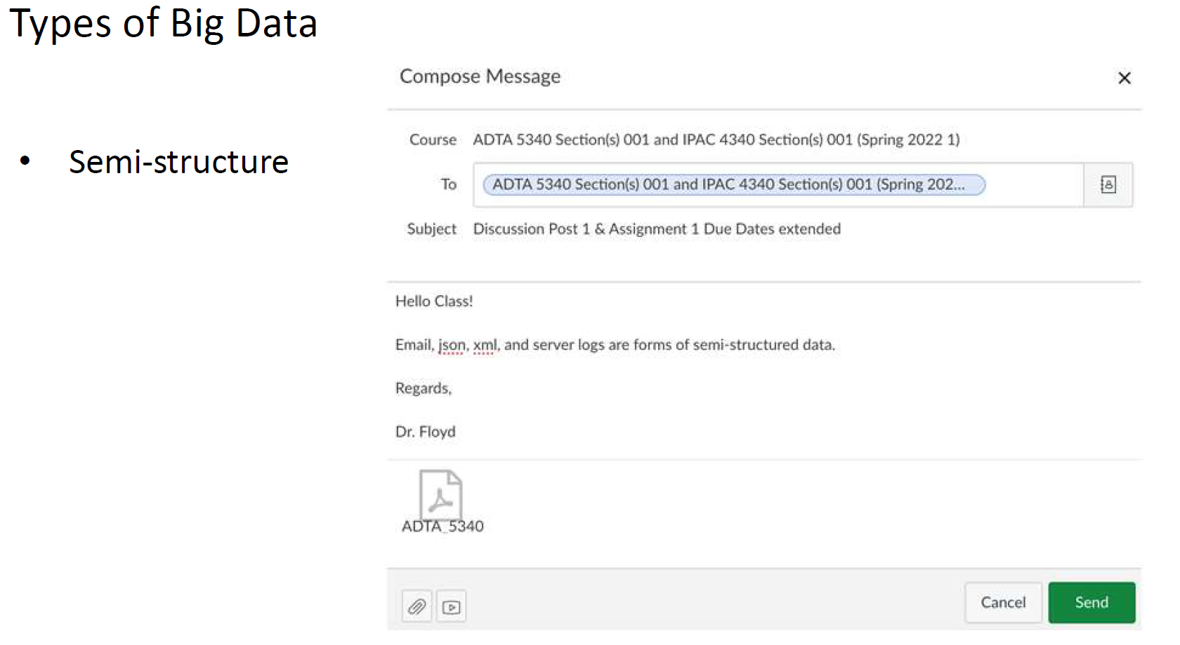

Slide 25
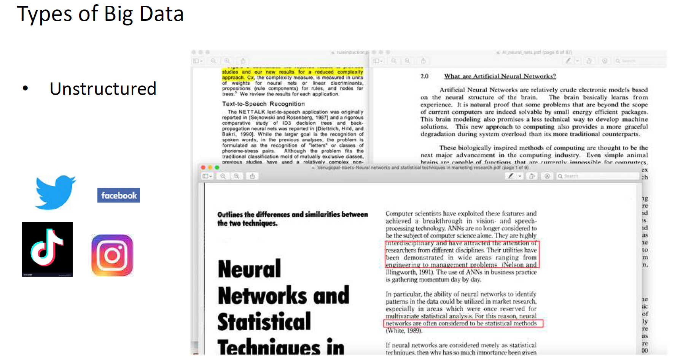

Slide 26

Visualizing Data: Graphical Techniques
Pie and bar charts – best for nominal (categorical) and ordinal data.
Histograms and Stem-and-Leaf Displays – best for interval (numeric) data.
Line charts – best for time series data
Scatter Diagram – best for two interval data points (x and y) independent and dependent.
The scatter diagram allows you to identify if there is a linear relationship (Strong, medium, weak, positive, negative, no relationship, and nonlinear.)

Slide 27

Introduction to Python and Jupyter Notebook
What is Python?
An easy to learn programming language used by many including web developers, application developers, and financial analysts.
A high-level programming language used by data scientists and analysts.
A high-level programming language developed by Guido van Rossum in 1991.

Slide 28
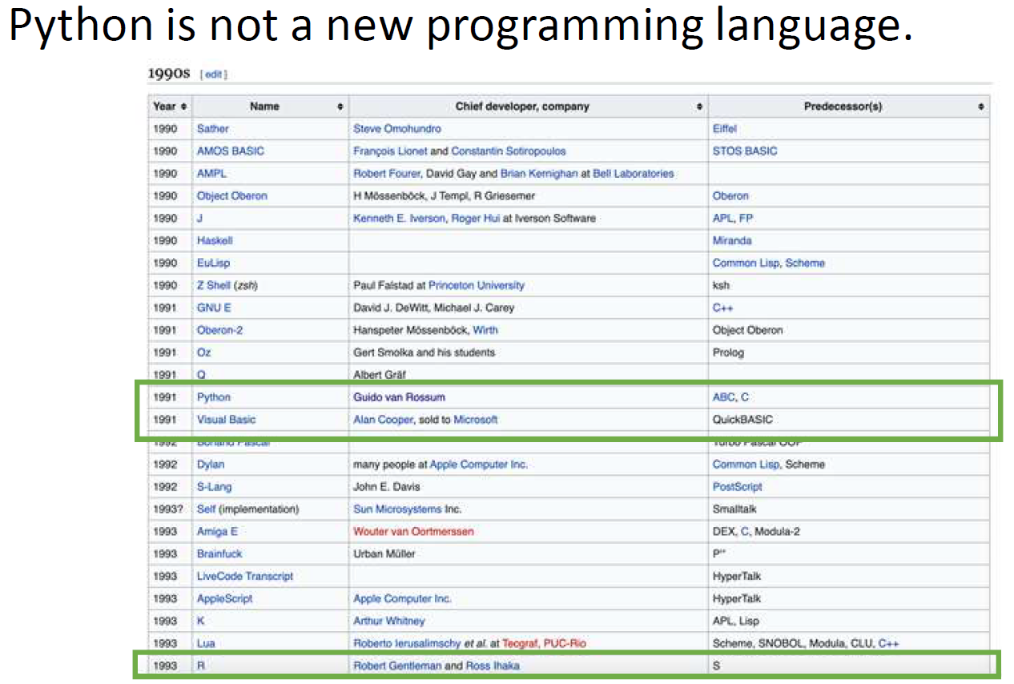
History of Python

Slide 29
History of Python
Created by Guido van Rossum in 1991 v 0.9.0
Python Version 1.x
1.0.4 released January 1994
Python Version 2.x
2.0.1 released January 2000
Python Version 3.x
3.0.1 released December 2008
3.10.2 released January 2022
3.10.4 released March 2022
Latest version is 3.1X.Y

Slide 30
Basics of Python
The twenty Zen of Python are guiding principles written by Pythoneer Tim Peters explaining the design of the Python programming language by Guido van Rossum.
1. Beautiful is better than ugly.
2. Explicit is better than implicit.
3. Simple is better than complex.
4. Complex is better than complicated.
5. Flat is better than nested.
6. Sparse is better than dense.
7. Readability counts.
8. Special cases aren't special enough to break the rules.
9. Although practicality beats purity.
10. Errors should never pass silently.
11. Unless explicitly silenced.

Slide 31
Basics of Python
The twenty Zen of Python are guiding principles written by Pythoneer Tim Peters explaining the design of the Python programming language by Guido van Rossum.
12. In the face of ambiguity, refuse the temptation to guess.
13. There should be one-and preferably only one --obvious way to do it.
14. Although that way may not be obvious at first unless you’re Dutch.
15. Now is better than never.
16. Although never is often better than *right* now.
17. If the implementation is hard to explain, it's a bad idea.
18. If the implementation is easy to explain, it may be a good idea.
19. Namespaces are one honking great idea -let's do more of those!
20. Pending Guido van Rossum response

Slide 32
Python: Basic Features and Concepts
• Expressive language (less coding is possible as compared to other languages)
• Syntax is easy to understand (when comparing with other languages)
• Cross-platform (Windows, Linux, macOS & Cloud Providers)
• General-purpose programming language
• Powerful programming language
• CaSe-SeNsItIvE programming language
• Programs are created using high-level programming languages of which code is understandable by humans.
Notes:
• Computers only understand those written in binary, i.e., 0’s and 1's
• An interpreter or a compiler does the conversion of the source code into the machine code.

Slide 33
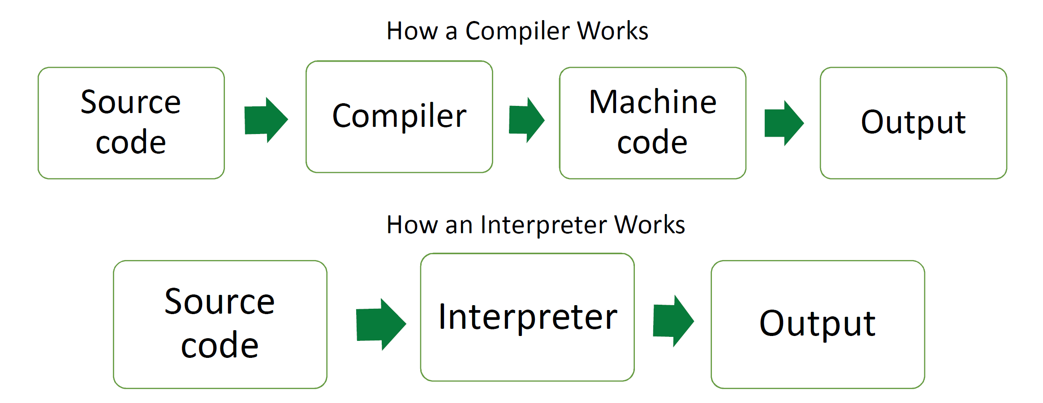
Basic Features and Concepts

Slide 34
Why Python
Makes your life easier as a student
• It can be taught in one single module
• Easy enough for elementary and middle school students
• Most popular language for introduction to computer science courses at top colleges and universities
• Faster development time
• Fastest-growing major programming language
• Facilitates very powerful tools for data analysis which is sometimes unparalleled in other programming languages

Slide 35
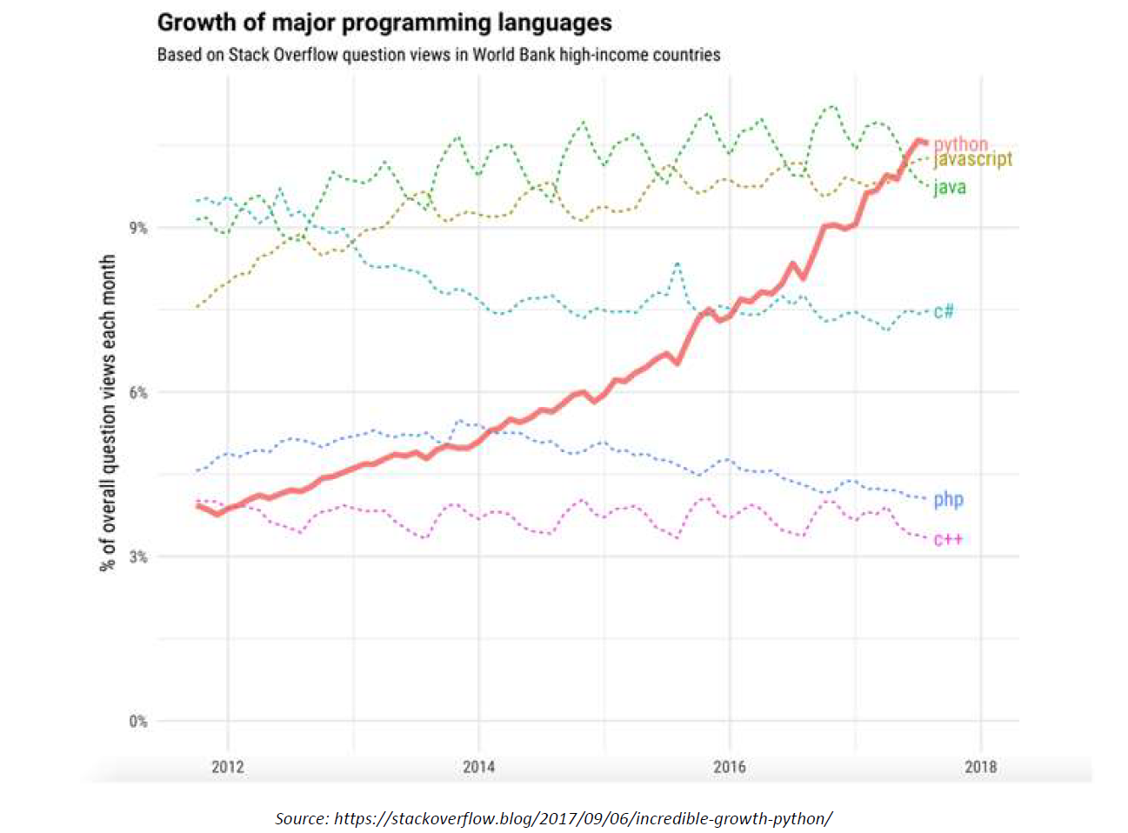
Why Python

Slide 36

Why? https://www.youtube.com/watch?v=YqxeLodyyqA&t=1s

Slide 37
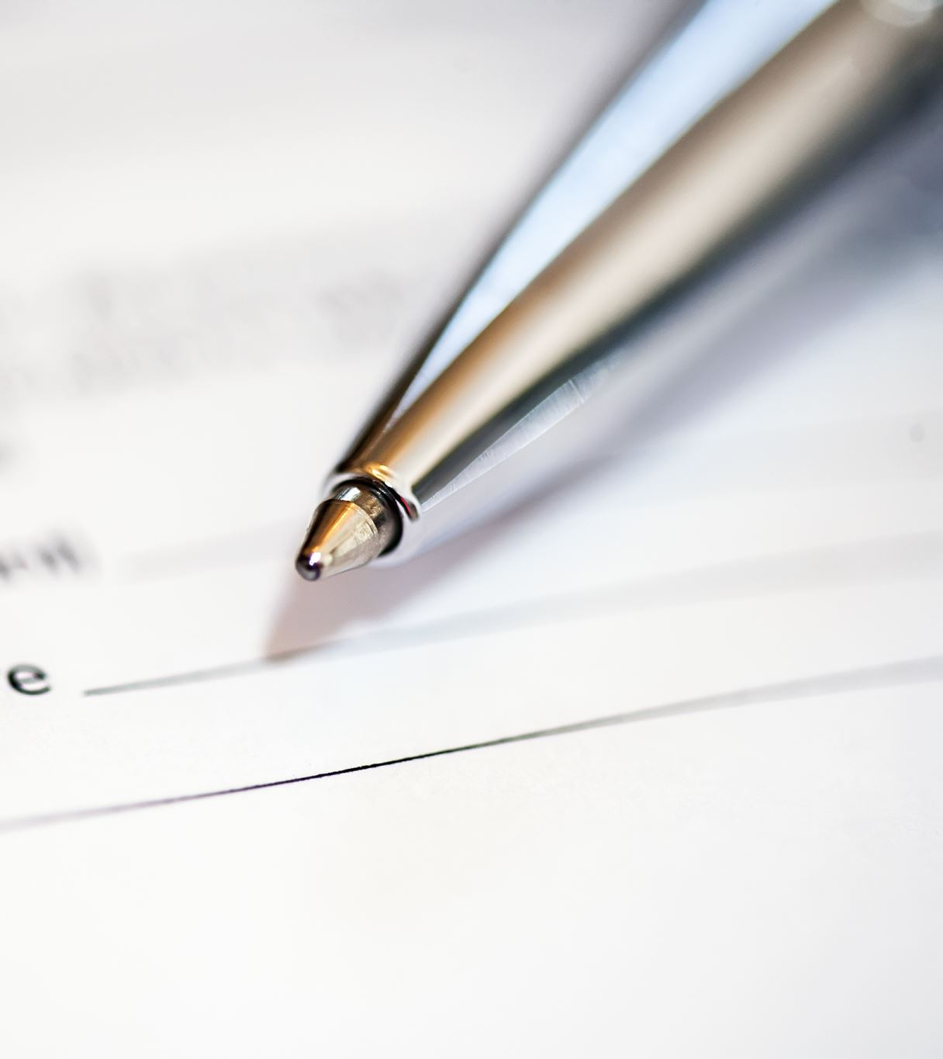
Helpful Resources
• Python.org and docs.python.org
• Stackoverflow
• Github
• Kaggle
• LinkedIn Learning courses
• w3 Schools
• Google Colab

Slide 38
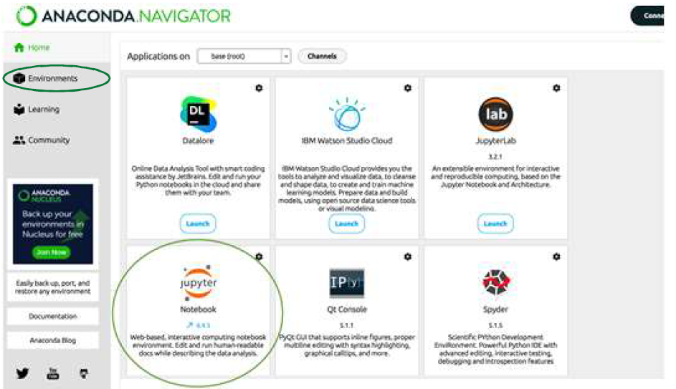
Installing Jupyter Notebook
Install & Setup Anaconda and thus Python
https://www.anaconda.com/products/distribution
Jupyter Notebook

Slide 39

Questions, Comments, Contributions

